Slide 1

Entity Linking with a Knowledge Base
Wei Shen, Jianyong Wang

Slide 2
CONTENTS
1
Introduction
2
Entity Generation
3
Entity Ranking
4
Unlinkable Prediction
5
Evaluation

Slide 3
1
Introduction
1-1
Entity Linking
1-2
Three modules of System

Slide 4
Entity Linking
Michael J. Jordan
Mapping an input text to corresponding unique entities in a target knowledge base.
Michael Jordan
(born 1963)
is a basketball player…
Michael l. Jordan
Michael W. Jordan

Slide 5
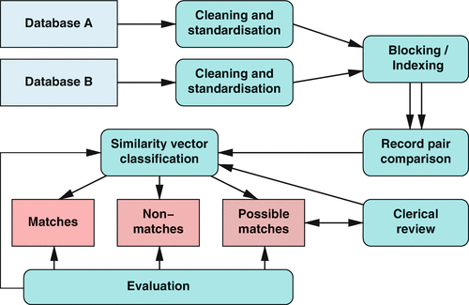
Entity Linking
Record Linkage : Matching records from several databases or sources that refer to the same entities.
Notes:
https://link.springer.com/referenceworkentry/10.1007%2F978-1-4899-7687-1_712

Slide 6
Three modules of System
Contains possible entities that entity mention m may refer to.
Candidate
Entity
Generation
Information Extraction
Information Retrieval
Content Analysis
Q/A
Entity
Linking
System
Leverage different kinds of evidence to rank the candidate entities, To find most likely one.
Candidate
Entity
Ranking
Unlinkable
Mention
Prediction
Some target entity for mention m, they return NIL for mention m.

Slide 7
2
Entity Generation
2-1
Name Dictionary Based
2-2
Surface Form Expansion

Slide 8
Name Dictionary Based
Entity Pages
Bold Phrases
From the first paragraphs
Page describes a single entity and contains the information of D
In first paragraph of Wikipedia article is summary of whole article.
Each of the bold phrases is added to the key column in D as a name K.
Redirect Pages
Hyperlinks in Wikipedia
Alternative name of D could be used to refer to an existing page
(ex. Microsoft Corporation
-> Microsoft)
The anchor text, link to useful source of synonyms, and could be regarded as a name of that linked entity
The name dictionary D
<key, value> mapping
Disambiguation Pages
Information of D
For separate each entities from multiple entities in Wiki.
Very useful in extracting abbreviations.
For adding to Entity Pages, various information of D.

Slide 9
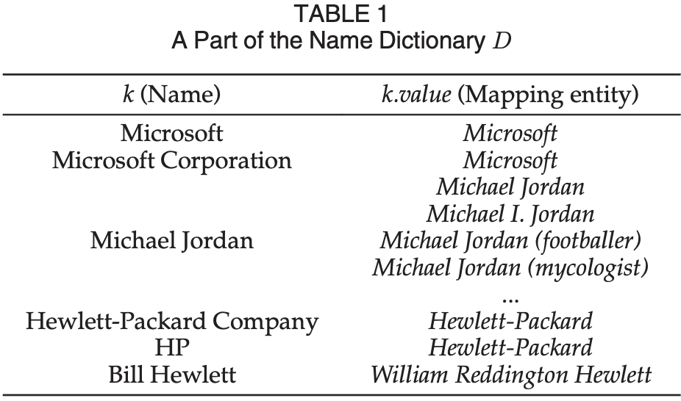
Name Dictionary Based

Slide 10
Surface Form Expansion
1. Heuristic Based Methods
1-1. Acronym Form
University
Illinois
Urbana-champaign
(UIUC)
A Parenthesis
(most common pattern)
1-2. Expanded Acronym Form
Michael I. Jordan
Michael J. Jordan
“Jordan”
Michael Jordan
Removing words having the same initials as the characters of the acronym.
And Find N-continuous word.

Slide 11
Surface Form Expansion
2. Supervised Learning Methods
1-1. Acronym Form
CCP-”Communist Party of China”
DOD-”United States Department of Defense”
.ETC
Communist
Party
of China
Leaders…
“CCP”

Slide 12
3
Entity Ranking
3-1
Supervised Ranking
Features
3-2
Unsupervised Ranking

Slide 13

Supervised Ranking Methods
Binary Classification
Pair<entity mention(m), candidate entity(e)>
The training phase : It used to learn the classifier
The test phase : It is presented to the classifier and indicate positive or negative.
Learning to Rank
For learning to rank framework, Using a max-margin tech based on training data set.
And utilize the ranking SVM framework.
The popularity knowledge – The likelihood of an entity appearing in a document.
The name knowledge – The possible names of an entity.
The context knowledge – The likelihood of an entity appearing in a specific context.
With these knowledge, generate the probabilistic model.
Probabilistic
Model Combination
添加标题
For overcome the weakness of a single model, Using model combination for the entity linking task.

Slide 14
Unsupervised Ranking Methods
VSM Based
First, calculating the similarity between the vectorial representation of the entity mention and the vectorial representation of the candidate entity. The highest similarity one is selected as the mapping entity for the entity mention.
Information Retrieval Based
Each candidate entity is indexed as a separate document and generate a search query.
And the search query is given to the candidate entity index and the candidate entity which has the highest relevant score is retrieved as the mapping entity.

Slide 15
4
Unlinkable Prediction
4-1
Name Dictionary Based
4-2
Surface Form Expansion

Slide 16
4. Unlinkable Mention Prediction
NIL threshold
NIL threshold
Top ranked of entity e
NIL
Binary Classification
Output a label
Pair<entity mention, top-ranked candidate entity>
Positive : mapping
Negative : NIL

Slide 17
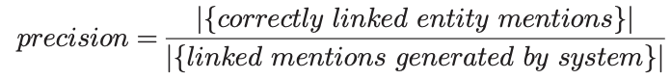
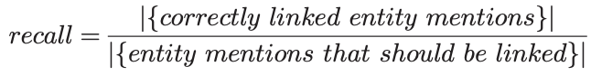
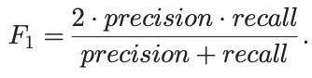
5. Evaluation
Evaluation Measures
Precision
Determine how correct entity mentions linked by the entity linking system.
Recall
Determine how correct linked entity mentions are with regard to total entity mentions.
F1-measure
(accuracy)
The harmonic mean of precision and recall, Same with accuracy is calculated as the number of correctly linked entity mentions divided by the total number of all entity mentions.

Slide 18
6. Conclusion
The entity linking task is highly data dependent.
It is difficult to determine which techniques are best suited and there are many aspect affect the design of the system..
1
As different types of data have various characteristics, it is very meaningful and necessary to develop specific techniques to deal with linking entities in them.
2
the increasing amount of web data is going to make this issue more prevalent in the future. Therefore, a promising direction for future research is to devise techniques that can substantially improve the efficiency and scalability while remaining the high accuracy.
Domain-specific entity linking focuses on a specific domain of data, and the domain-specific knowledge bases may have different structures with the general purpose knowledge bases.
The task of associating search engine queries with entities from a large product catalog.
3

